Slide 1
NOAA Fisheries Steller Sea Lion Population Count

Slide 2
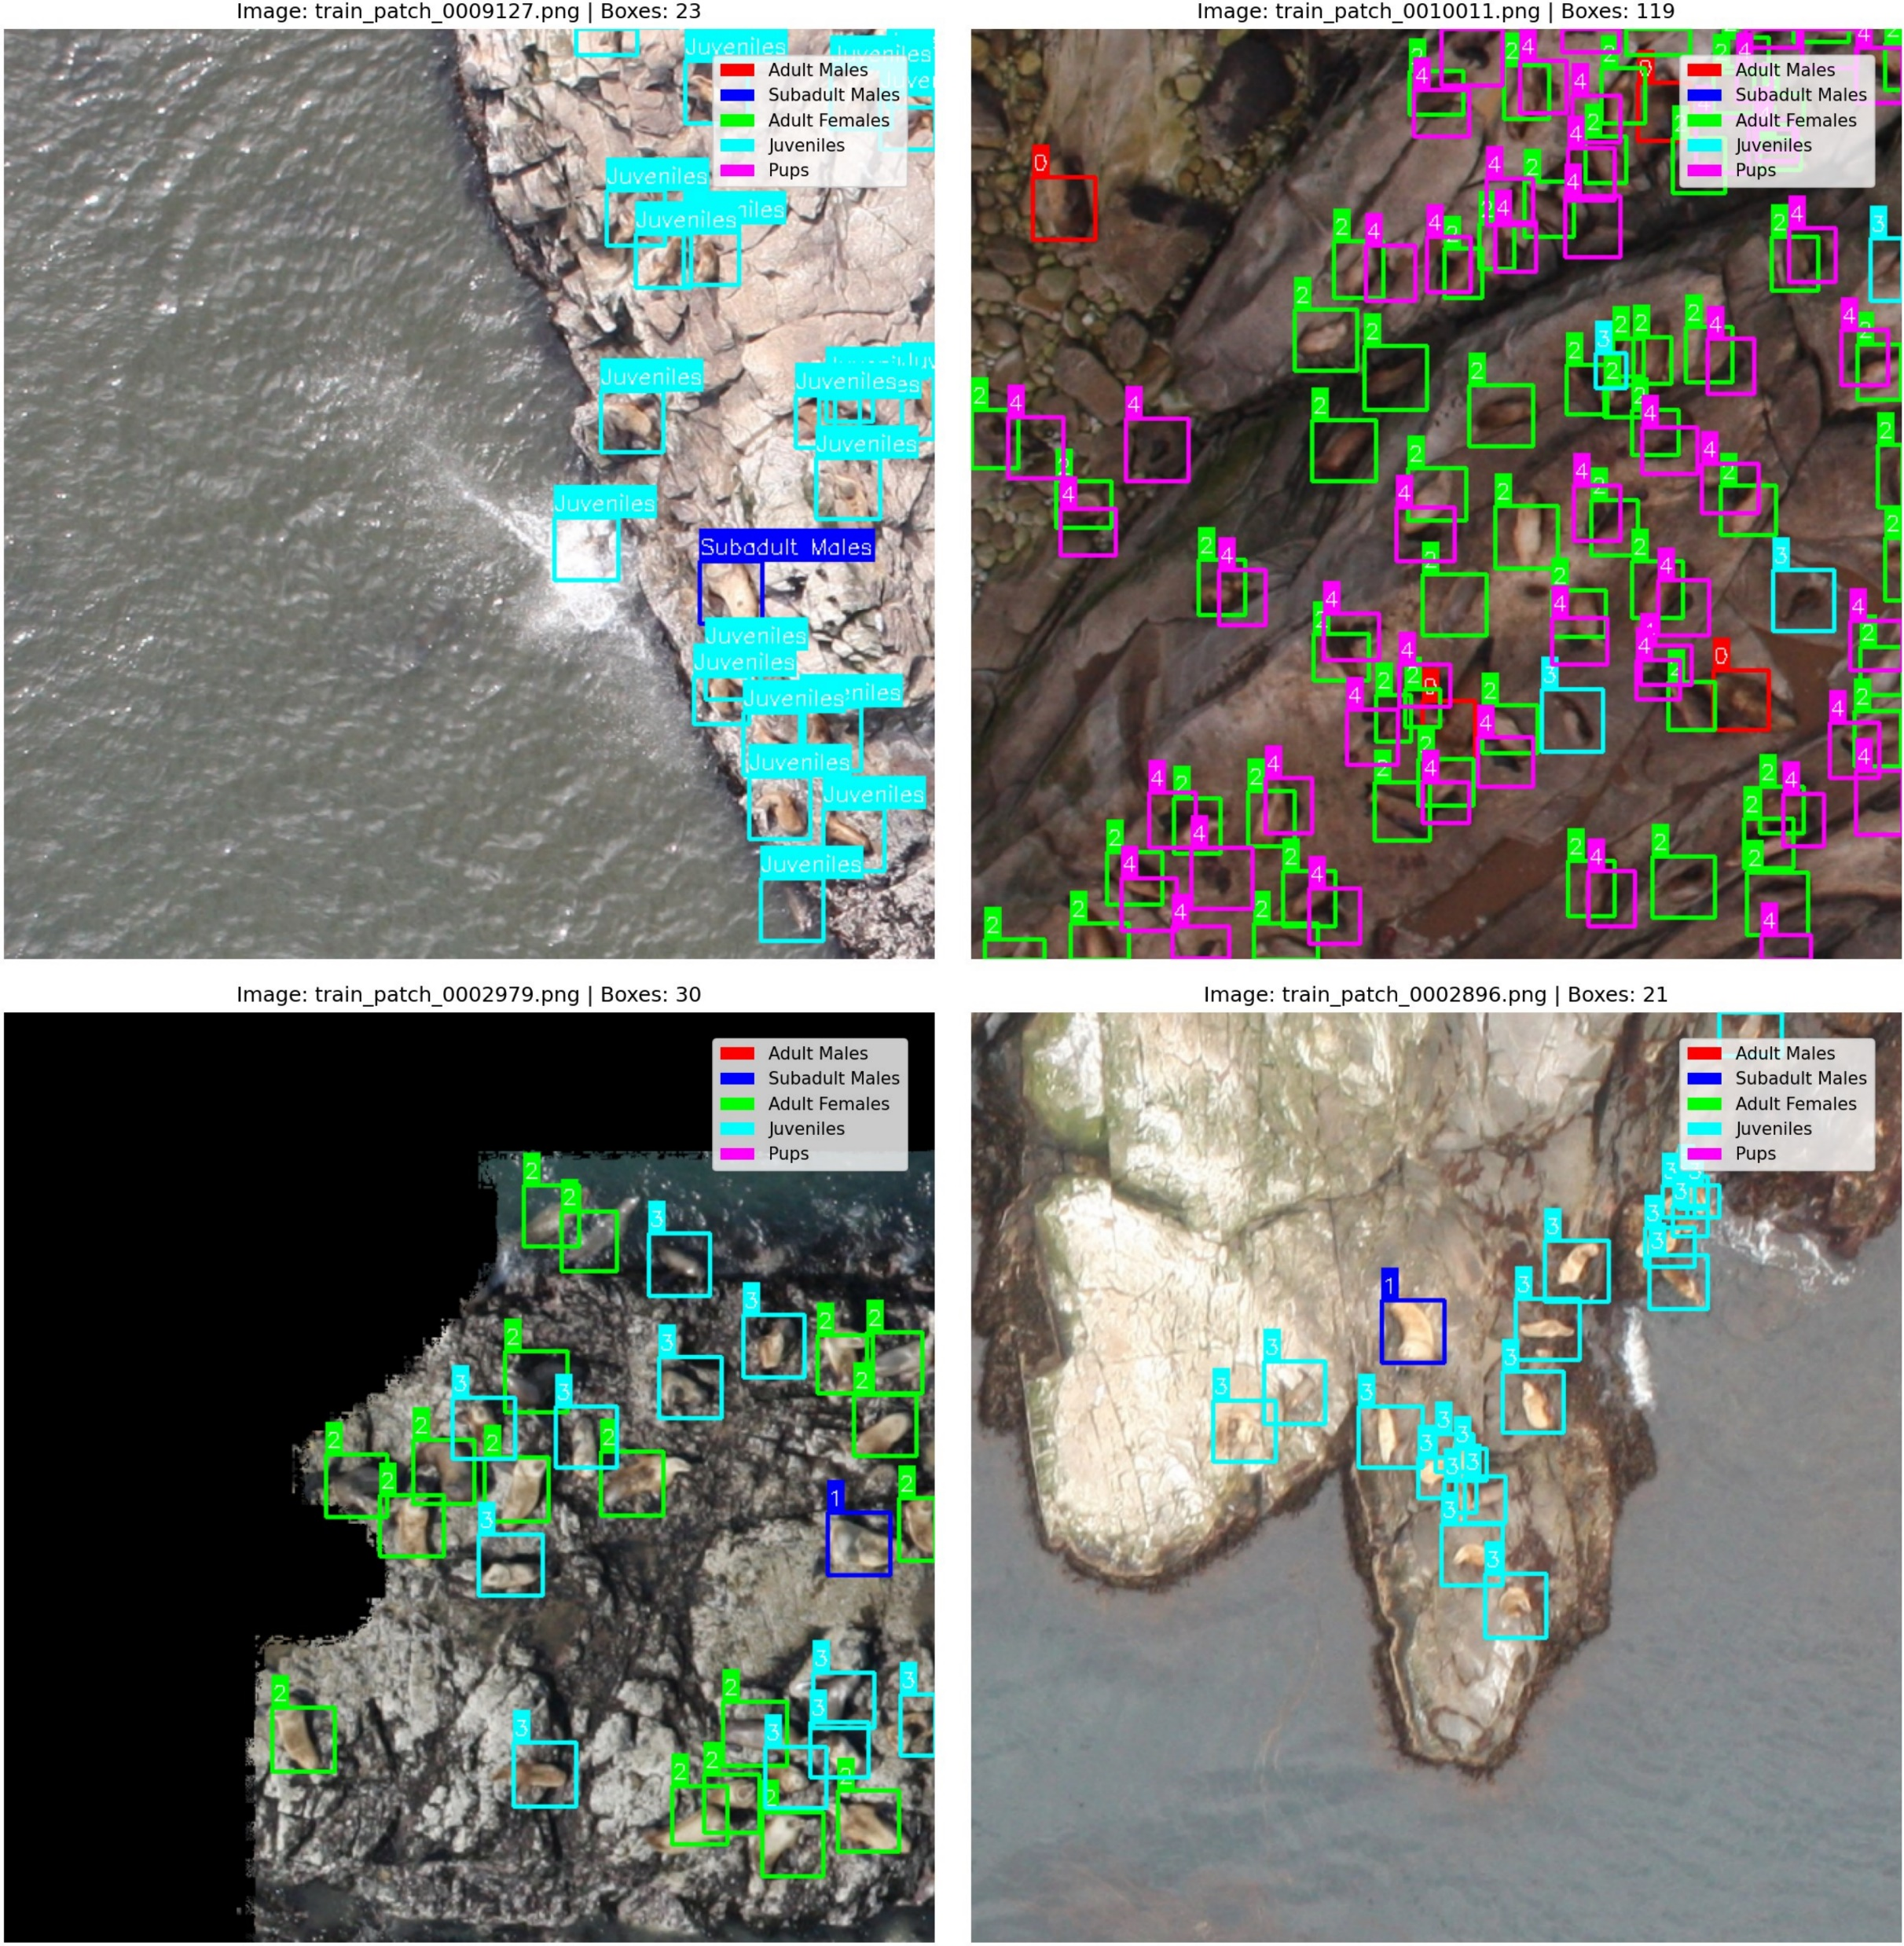
Group 22
NOAA Fisheries Steller Sea Lion Population Count

